Slide 1

Flask App In-Class Exercise
https://github.com/pgolbus/411-examples
A semester’s worth of material in 30 minutes or less for you to copy-pasta
(But don’t use jQuery)
CS411 Spring 23
Peter B. Golbus

Slide 2
Tomorrow
2 project ideas
Simple paragraph.
What’s it going to do.
What 2 APIs will you look for.
Do you know what you’ll use the DB for?
You can always do users
Any idea what tech stack you’ll use?
It’s ok if the answer is no

Slide 3

Web Server Gateway Interface?

Slide 4
What is Flask?
Flask is a Python micro web framework
It generates http responses and nothing else

Slide 5
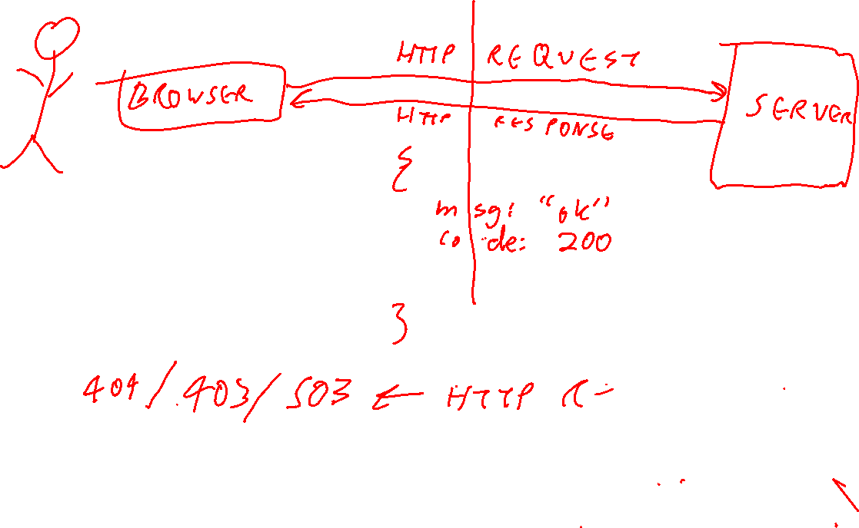
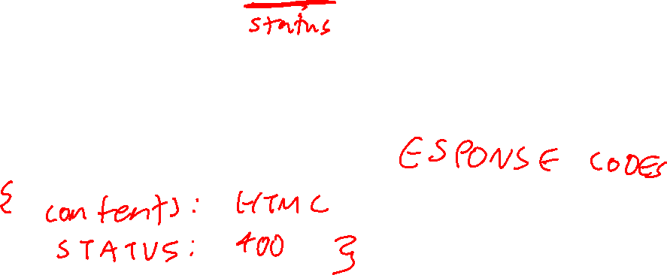

Slide 6
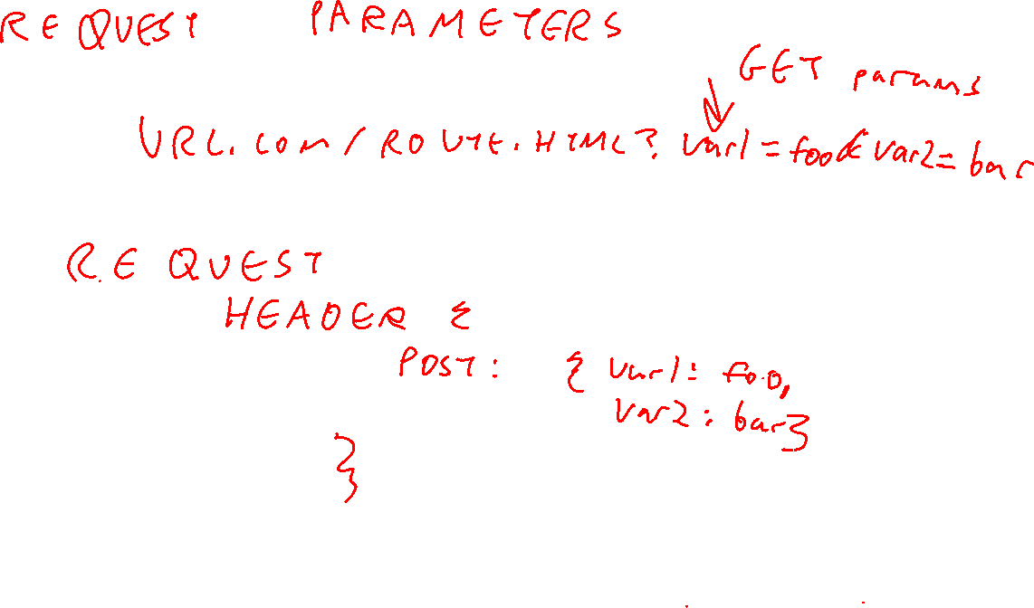

Slide 7
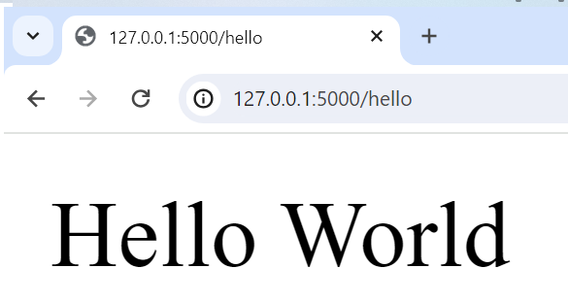
Anatomy of hello world
route
from flask import Flask
app = Flask(__name__)
@app.route('/hello')
def main():
app.logger.info("Hello world")
return "Hello World", 200
if __name__ == "__main__":
# to run me from the command line: <flask --app main run> or <python app.py>
#
app.run(host='0.0.0.0', port=5000, debug=True)
app
host

Slide 8
Layout of a flask app
webapp/
| webapp/
| | __init__.py
| | utils.py
| | logger.py
| | webapp_model.py
| static
| | css
| | | style.css
| | javascript
| | | webappView.js
| | images / assets / whatever
| templates
| | index.html
| app.py
| requirements.txt
| requirements.lock

Slide 9
Requirements.*
Top level requirements for a human
requirements.txt
All requirements for deployment
requirements.lock
Flask==2.2.3
click==8.1.3
Flask==2.2.3
importlib-metadata==6.0.0
itsdangerous==2.1.2
Jinja2==3.1.2
MarkupSafe==2.1.2
mysql-connector-python==8.0.32
protobuf==3.20.3
Werkzeug==2.2.3
zipp==3.15.0

Slide 10
Virtualenvs
DON’T INSTALL DEPENDENCIES INTO YOUR SYSTEM PYTHON ENVIRONMENT
python -m venv /path/to/new/virtual/environment
source /path/to/new/virtual/environment/bin/activate
pip install –r requirements.lock
When you are done
deactivate

Slide 11
But just do this
Setup python, pip, virtualenv and virtualwrapper, with zsh on a new machine (github.com)

Slide 12
Installing requirements with pip
Install requirements
pip install flask
Generate lock file
pip freeze > requirements.lock
Install from file
pip install –r requirements.lock

Slide 13
Injecting HTML with Jinja2 templates
{{ variables }},
{% if conditionals %}
{% for loops in lists %}
Not really a frontend / backend. This is all backend

Slide 14
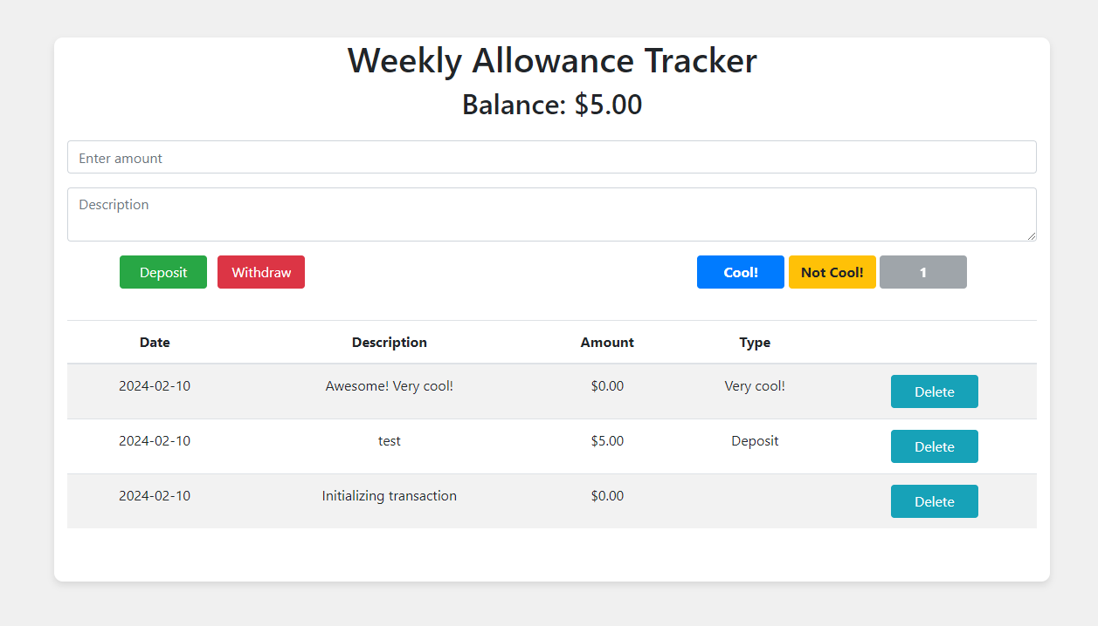
Allowance app
Webview in front of a db table
SQLite is a rdbms that stores small databases in flat text files
Constants stored in .env file
People have the weirdest hobbies

Slide 15
Dynamic HTML with jQuery*
* This is a really outdated way to do this, but React / Vue / Angular require setup. This we can just use
Problem: Encapsulation of concerns
I don’t want my microservice drawing pictures
Templating: inject dynamic results into response
AJAX: dynamically update HTML in the client

Slide 16
Mastermind
Pure jinja2 template (font-size 3) Re-render index every time
Jinja2 template for jQuery (font size 6)
Load index once and update dynamically
<table id="guessTable" class="moveTable">
<tr>
<td>Move</td>
{% for index in range(size) %}
<td>Color {{ index + 1 }}</td>
{% endfor %}
<td>Correct Position</td>
<td>Correct Color</td>
</tr>
{% for guess in guesses %}
<tr>
<td>{{ loop.index }}</td>
{% for color in guess[:size] %}
<td style="background: {{ pattern_colors[color] }}"></td>
{% endfor %}
{% for result in guess[size:] %}
<td>{{ result }}</td>
{% endfor %}
</tr>
{% endfor %}
</table>
{% if win %}
<div>
You won in {{ guess_count }} guesses!
</div>
{% elif lose %}
<div>
You lose!
</div>
{% else %}
<div id = selectDiv>
<form action="guess" method="post">
<table>
<tr>
{% for index in range(size) %}
<td>Color {{ index + 1 }}</td>
{% endfor %}
</tr>
<tr>
{% for index in range(size) %}
<td>
<select id="color{{ index + 1}}" name="color{{ index + 1 }}">
{% for color in pattern_colors %}
<option name="{{ color }}" value="{{ loop.index - 1}}">{{ color }} </option>
{% endfor %}
</select>
</td>
{% endfor %}
</tr>
</table>
<button type="submit">Guess</button>
</form>
</div>
{% endif %}
<form action="reset" method="post">
<button type="submit">Reset</button>
</form>
</div>
<table id="guessesTable">
<tr>
<td>Move</td>
{% for index in range(size) %}
<td>Color {{ index + 1 }}</td>
{% endfor %}
<td>Correct Position</td>
<td>Correct Color</td>
</tr>
</table>
<div id="selectDiv">
<table id="selectTable">
<tr>
{% for index in range(size) %}
<th>Color {{ index + 1 }}</th>
{% endfor %}
</tr>
<tr>
{% for index in range(size) %}
<td>
<select id="color{{ index + 1}}" name="color{{ index + 1 }}">
{% for color in pattern_colors %}
<option name="{{ color }}" value="{{ loop.index - 1}}">{{ color }} </option>
{% endfor %}
</select>
</td>
{% endfor %}
</tr>
</table>
<button id="guessButton">Guess</button>
</div>
<div id="endGameDiv"></div>
<div id="resetDiv">
<button id="resetButton">Reset</button>
</div>

Slide 17
De-Coupled Web Architecture
jQuery API calls
Flask routes
jQuery HTML updates
Python game logic

Slide 18
Concentration / Mastermind 2 ways
You are given
Python model
jinja2 template (blank for pure backend mastermind)
app.py with all Flask removed
js view with API calls unimplemented
Go nuts. Pair programming encouraged

